Slide 1

Leave Management System
Dharamsinh Desai University
Faculty of Information Science (B.C.A)
Under Guidance OF:-
Internal Guide:-
Prof. K.u.acharya
External Guide:-
Ms. Manali Bhosale
Presented By:-
Chirag prajapati
(14B092)

Slide 2


Contents
About The System
Existing System
Proposed System
System Flow Chart
Data Flow Diagram
Entity Relationship Diagram
Data dictionaries
Screen Layout
System Generated Reports
Scope & Limitation
Future Expansion

Slide 3
About The System
The Leave Management System is a Web Based Application that can be used over internet.
It is Standardizes a process for Organization as per Requirements.
It uses the standard leave process of apply and approve leave request.
In this system employee can apply leave and see their leave balance.
Manager can approve or reject leave.
Admin can export required report for employees payroll, and manage system to maintain company policy.
In this system also provided some features like, leave summary chart, historical leave, employee upcoming birthday notification, email notification, etc…

Slide 4
Existing System
Right now whenever Company employee willing to take leave, he/she sends an email to manager and CC human resource team.
Managers approve or cancel the leave by replying to email.
Human resource team manages an excel sheet in which employee leave is marked and updated balanced provided to employee over email.

Slide 5
Existing System Cont…
Drawbacks:-
Time Consuming.
It difficult to maintain user leave record.
User need manual calculation for available leave balance.
HR person has required to manage excel sheet for leave record.
HR person has required to maintain manual report for payroll.

Slide 6
Proposed System
The aim of proposed system is to develop a system of improved facilities.
The proposed system can overcome all the limitations of the existing system and it help the user to reduce the workload and mental conflict.
For that Company willing to develop a web application which allows employees to apply for leave and see their leave balance, allow manager to approve/reject leave and allow HR people to export required reports for payroll of the employees.

Slide 7
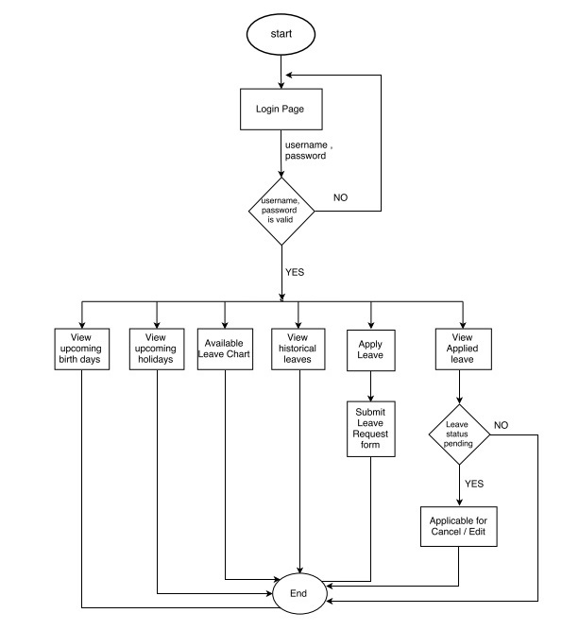
Employee Flowchart

Slide 8
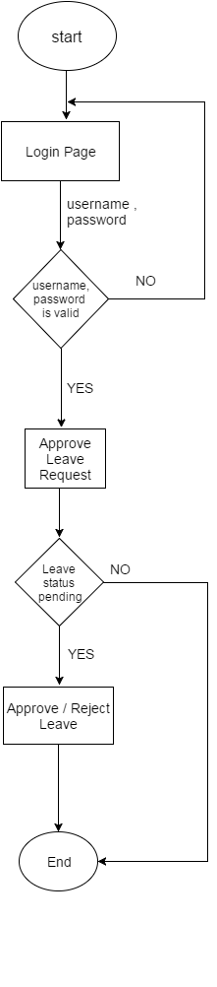
Manager Flowchart

Slide 9
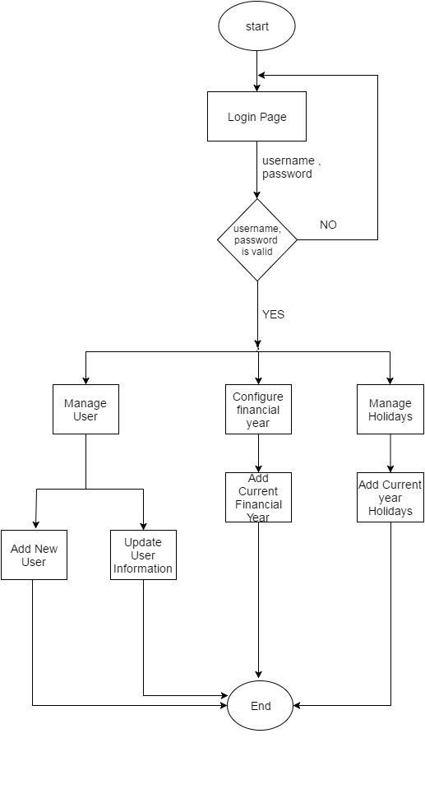
Admin Flowchart

Slide 10
Context Diagram

Slide 11
Employee First Level DFD

Slide 12
Manager First Level DFD

Slide 13
Admin First Level DFD

Slide 14
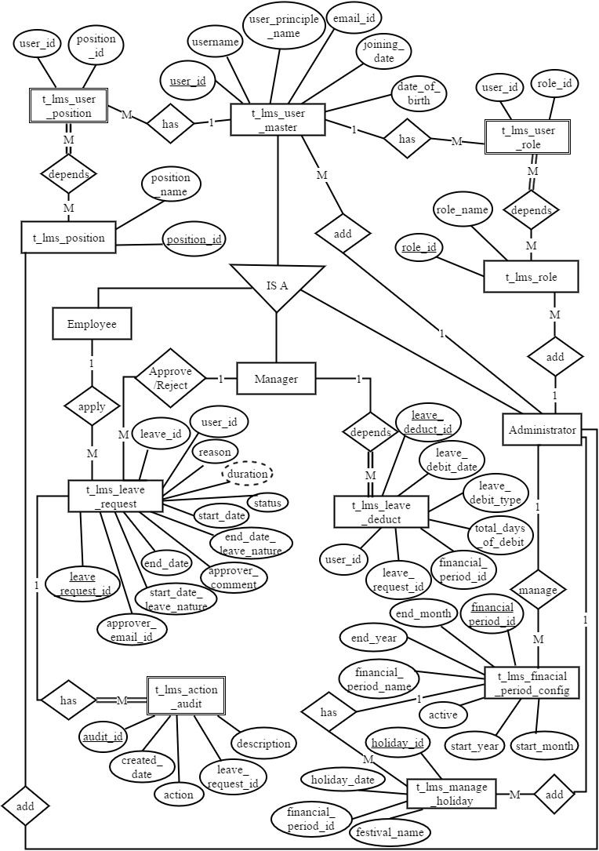
Entity Relationship Diagram

Slide 15
Data Dictionary

Slide 16
Table Name : t_lms_financial_period_config Description: This table contains information of financial period.
No. | Fields Name | Data Type | Contains | Description
1. | financial_period_id | NUMERIC(19,0) | PRIMARY KEY, NOT NULL | Id of financial period
2. | end_month | VARCHAR(255) | NULL | detail about ending month in financial period
3. | end_year | INT | NULL | ending year of financial period
4. | financial_period_name | VARCHAR(255) | NULL | name of financial period
5. | is_active | BIT | NULL | status of financial period
6. | start_month | VARCHAR(255) | NULL | starting month of financial period
7. | start_year | INT | NULL | starting year of financial year

Slide 17
Table Name : t_lms_user_master Description: t_lms_user_master table contain the details of system user.
No. | Fields Name | Data Type | Contains | Description
1. | user_id | NUMERIC(19,0) | PRIMARY KEY, NOT NULL | contain Id of user
2. | username | VARCHAR(255) | NULL | contain username
3. | user_principal_name | VARCHAR(255) | NULL | contain user full name
4. | email_id | VARCHAR(255) | NULL | contain user email id
5. | joining_date | DATETIME | NULL | contain user joining date
6. | date_of_birth | DATETIME | NULL | contain user birth date

Slide 18
Table Name : t_lms_role Description: t_lms_role table contain the name of different role for system.
No. | Fields Name | Data Type | Contains | Description
1. | role_id | NUMERIC(19,0) | PRIMARY KEY, NOT NULL | contain role id
2. | role_name | VARCHAR(255) | NULL | contain role name

Slide 19
Table Name : t_lms_user_role Description: t_lms_user_role table contain the detail of provided roles to user in system.
No. | Fields Name | Data Type | Contains | Description
1. | user_id | NUMERIC(19,0) | FOREIGN KEY, NOT NULL | contain user id
2. | role_id | NUMERIC(19,0) | FOREIGN KEY, NOT NULL | contain role id

Slide 20
Table Name : t_lms_position Description: t_lms_position table contain the name of different position in company.
No. | Fields Name | Data Type | Contains | Description
1. | position_id | NUMERIC(19,0) | PRIMARY KEY, NOT NULL | contain position id
2. | position_name | VARCHAR(255) | NULL | contain position name

Slide 21
Table Name : t_lms_user_position Description: t_lms_user_position table contain the details of assigned position to user in company.
No. | Fields Name | Data Type | Contains | Description
1. | user_id | NUMERIC(19,0) | FOREIGN KEY, NOT NULL | contain user id
2. | position_id | NUMERIC(19,0) | FOREIGN KEY, NOT NULL | contain position id

Slide 22
Table Name : t_lms_leave_type Description: t_lms_leave_type table contain the different type of leaves.
No. | Fields Name | Data Type | Contains | Description
1. | leave_type_id | NUMERIC(19,0) | PRIMARY KEY, NOT NULL | contain leave type id
2. | leave_type_name | VARCHAR(255) | NULL | contain leave type name
3. | no_of_allocated_days | FLOAT | NULL | contain no of day allocated to leave type
4. | leave_allocation_category | VARCHAR(255) | NULL | contain category of leave allocation

Slide 23
Table Name : t_lms_position_leave Description: t_lms_position_leave table contain the detail of allowed leave to different position user.
No. | Fields Name | Data Type | Contains | Description
1. | position_id | NUMERIC(19,0) | FOREIGN KEY, NOT NULL | contain position id
2. | leave_type_id | NUMERIC(19,0) | FOREIGN KEY, NOT NULL | contain leave type id

Slide 24
Table Name : t_lms_leave_incur Description: t_lms_leave_incur table contain the monthly increase applicable leave.
No. | Fields Name | Data Type | Contains | Description
1. | leave_incur_id | NUMERIC(19,0) | PRIMARY KEY, NOT NULL | contain leave incur id
2. | leave_incur_date | DATETIME | NULL | contain leave incur date
3. | leave_incur_type | VARCHAR(255) | NULL | contain leave incur type
4. | description | VARCHAR(255) | NULL | leave incur description
5. | system_generated_date | DATETIME | NULL | contain system generated date
6. | total_days_of_credit | FLOAT | NULL | contain no of day are credited
7. | financial_period_id | NUMERIC(19,0) | FOREIGN KEY, NULL | contain financial period id
8. | user_id | NUMERIC(19,0) | FOREIGN KEY, NULL | contain user id

Slide 25
Table Name : t_lms_leave_deduct Description: t_lms_leave_deduct table contain the deducted approved no of leave from total credited user leave.
No. | Fields Name | Data Type | Contains | Description
1. | leave_deduct_id | NUMERIC(19,0) | PRIMARY KEY, NOT NULL | contain leave deduct id
2. | leave_debit_date | DATETIME | NULL | contain leave debit date
3. | leave_debit_type | VARCHAR(255) | NULL | contain debited leave type
4. | total_days_of_debit | FLOAT | NULL | contain total debited leave days
5. | financial_period_id | NUMERIC(19,0) | FOREIGN KEY, NULL | contain financial period id
6. | leave_incur_id | NUMERIC(19,0) | FOREIGN KEY, NULL | contain leave incur id
7. | leave_request_id | NUMERIC(19,0) | FOREIGN KEY, NULL | contain leave request id
8. | user_id | NUMERIC(19,0) | FOREIGN KEY, NULL | contain user id

Slide 26
Table Name : t_lms_carry_forward_audit Description: t_lms_carry_forward_audit table contain detail of leave carry forward in next month/year.
No. | Fields Name | Data Type | Contains | Description
1. | carry_forward_id | NUMERIC(19,0) | PRIMARY KEY, NOT NULL | contain carry forward id
2. | current_year_leave_ balance | FLOAT | NULL | total no of applicable leave balance
3. | eligible_carry_forward | FLOAT | NULL | Yearly Leave Incur
4. | elapsable_carry_forward | FLOAT | NULL | Leave elapsable while leave balance greater than 42
5. | previous_year_leave_ balance | FLOAT | NULL | total no of leave of previous year
6. | total_credit_after_carry_ forward | FLOAT | NULL | total credited leave after carry forward

Slide 27
Continue… Table Name : t_lms_carry_forward_audit
No. | Fields Name | Data Type | Contains | Description
7. | current_year_id | NUMERIC(19,0) | FOREIGN KEY, NULL | current financial year id
8. | leave_incur_id | NUMERIC(19,0) | FOREIGN KEY NULL | leave incur id
9. | previous_year_id | NUMERIC(19,0) | FOREIGN KEY, NULL | previous financial year id
10. | user_id | NUMERIC(19,0) | FOREIGN KEY, NULL | system user id

Slide 28
Table Name : t_lms_leave_request Description: t_lms_ leave_request table contain the details of user applied leave request and that detail.
No. | Fields Name | Data Type | Contains | Description
1. | leave_request_id | NUMERIC(19,0) | PRIMARY KEY, NOT NULL | leave request id
2. | approver_email_id | VARCHAR(255) | NULL | leave approver email id
3. | contact_number | VARCHAR(255) | NULL | employee contact number
4. | duration | FLOAT | NULL | duration leave
5. | end_date | DATETIME | NULL | end date of leave
6. | end_date_leave_nature | VARCHAR(255) | NULL | type of end day lave (full, half)

Slide 29
Continue… Table Name : t_lms_leave_request
No. | Fields Name | Data Type | Contains | Description
7. | reason | TEXT | NULL | reason for apply leave
8. | start_date | DATETIME | NULL | start date of leave
9. | start_date_leave_nature | VARCHAR(255) | NULL | type of start date leave (full, half)
10. | status | NUMERIC(19,0) | NULL | status of leave action (panding,approved)
11. | leave_id | NUMERIC(19,0) | NULL | contain leave type id
12. | user_id | NUMERIC(19,0) | NULL | contain user id
13. | approver_comment | VARCHAR(255) | NULL | contain comment by approver

Slide 30
Table Name : t_lms_leave_email_token Description: t_lms_leave_email_token table contain the data of generated email token, which are send to manager / approver for perform action on it.
No. | Fields Name | Data Type | Contains | Description
1. | email_token_id | NUMERIC(19,0) | PRIMARY KEY, NOT NULL | contain email token id
2. | created_date | DATETIME | NULL | contain creation date of token
3. | state | VARCHAR(255) | NULL | contain token state (open, close)
4. | token | VARCHAR(255) | NULL | token description

Slide 31
Table Name : t_lms_manage_holiday Description: t_lms_manage_holiday table contain the data of current year holidays, it is maintained by system administrator.
No. | Fields Name | Data Type | Contains | Description
1. | holiday_id | NUMERIC(19,0) | PRIMARY KEY, NOT NULL | contain holiday id
2. | holiday_date | DATETIME | NULL | contain holiday date
3. | festival_name | VARCHAR(255) | NULL | contain name of festival
4. | financial_year_config_id | NUMERIC(19,0) | FOREIGN KEY, NULL | contain financial year id

Slide 32
Screen Layout

Slide 33
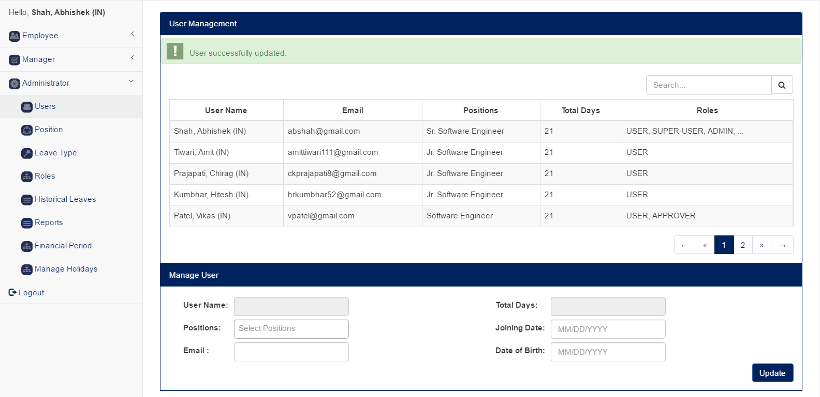
Users Management Screen

Slide 34
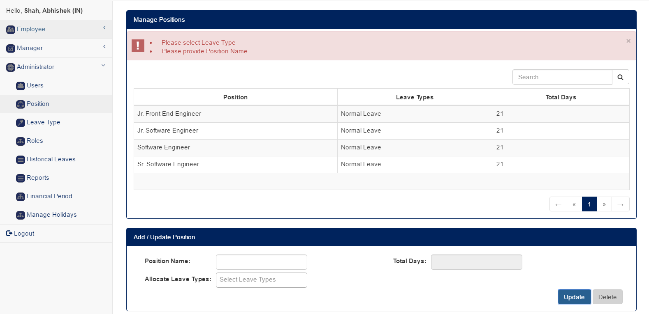
User Position Management Screen

Slide 35
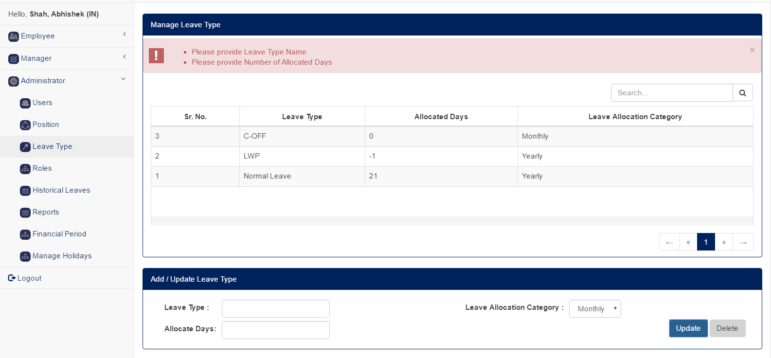
Leave Type Management Screen

Slide 36
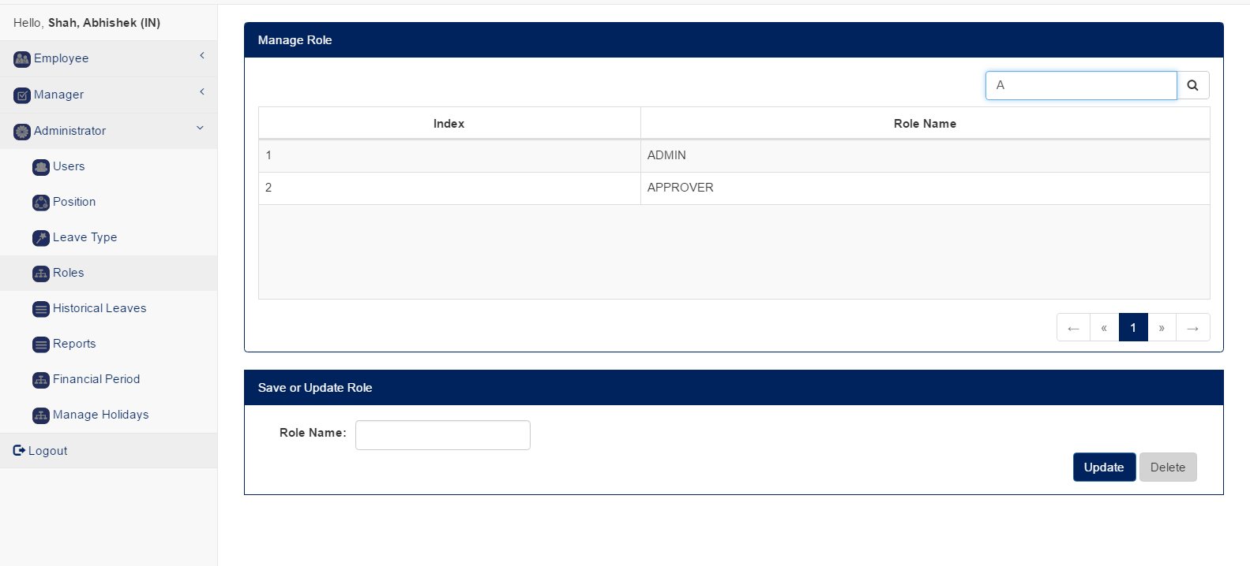
Roles Management Screen

Slide 37
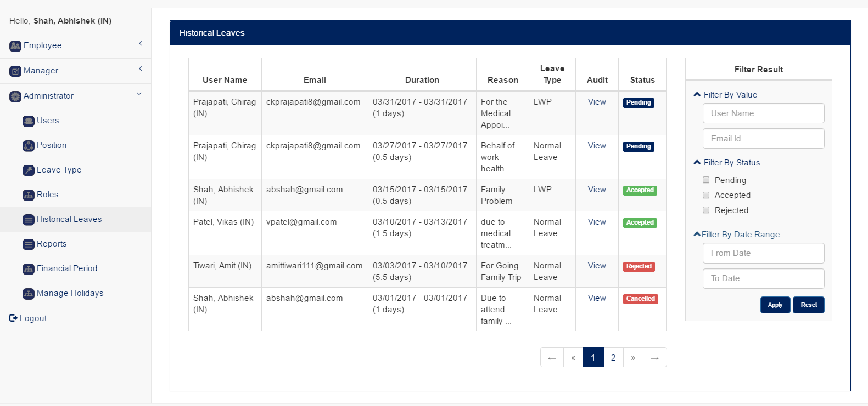
Historical Leave Screen

Slide 38
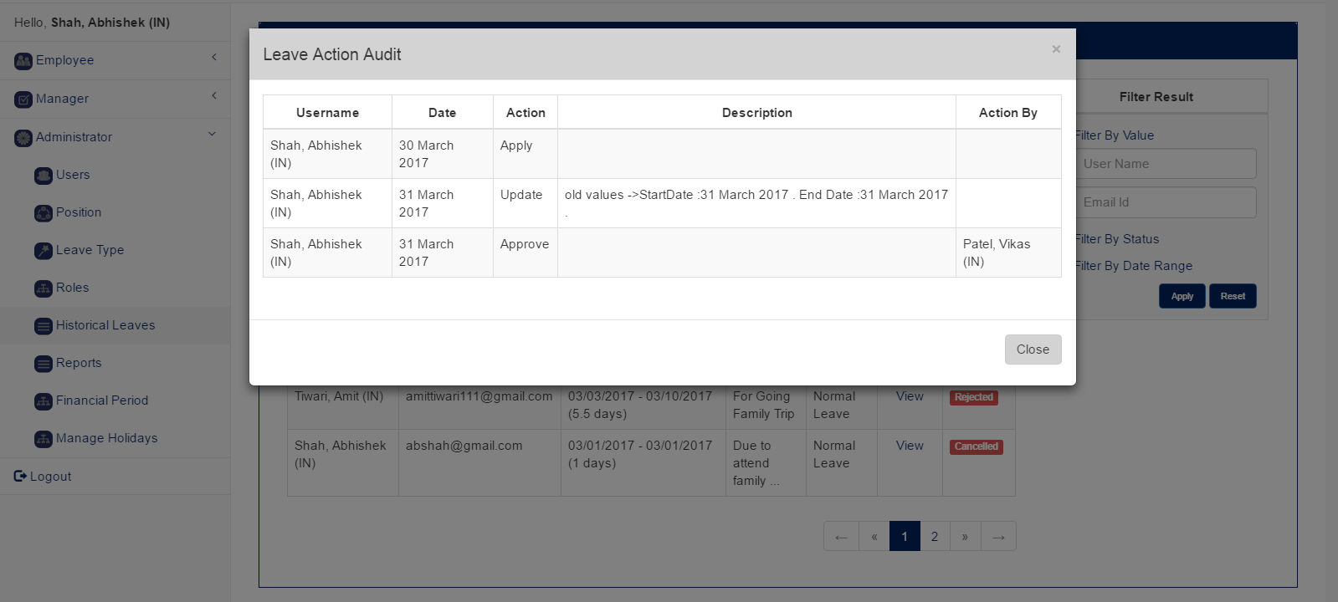
Leave Action Audit Screen

Slide 39
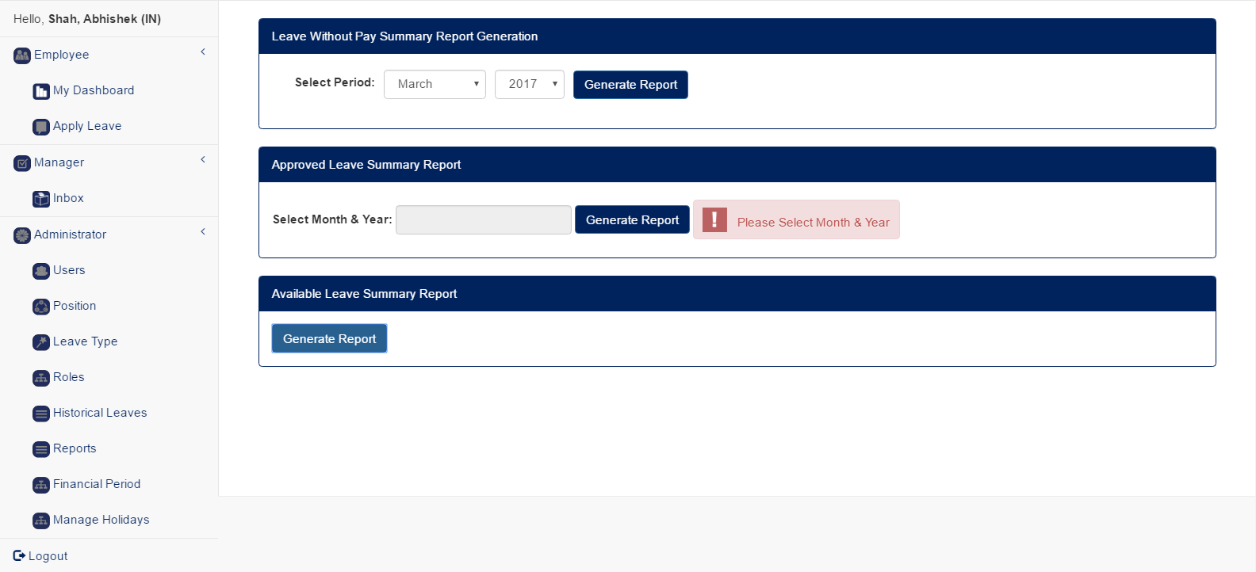
Reports Screen

Slide 40
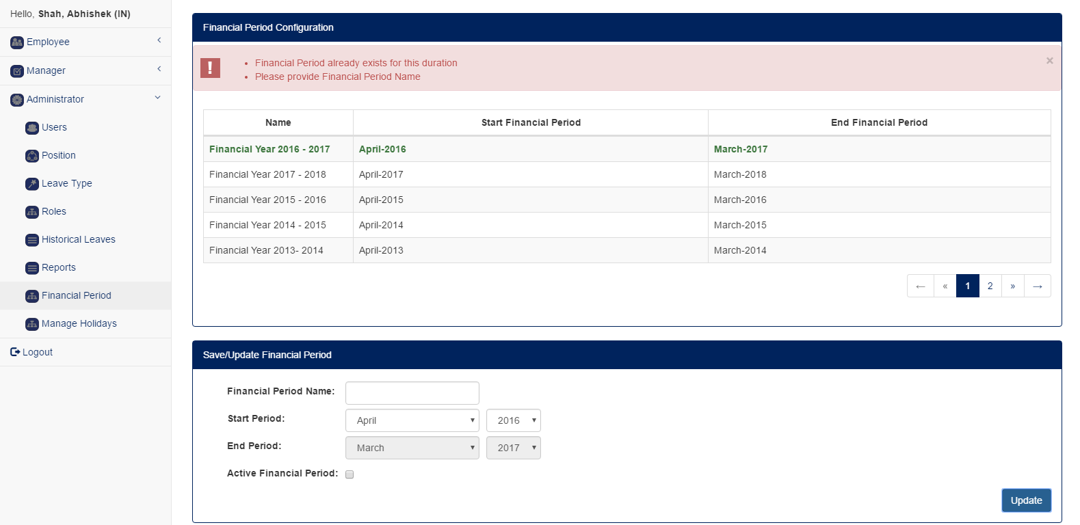
Financial Period Configuration Screen

Slide 41
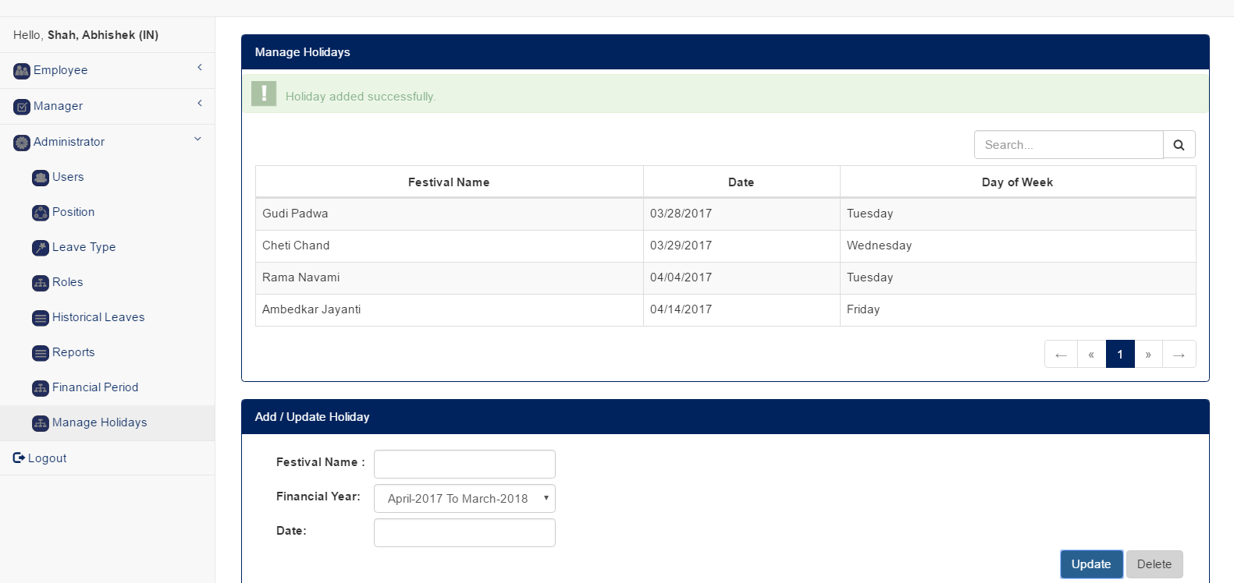
Holiday Management Screen

Slide 42
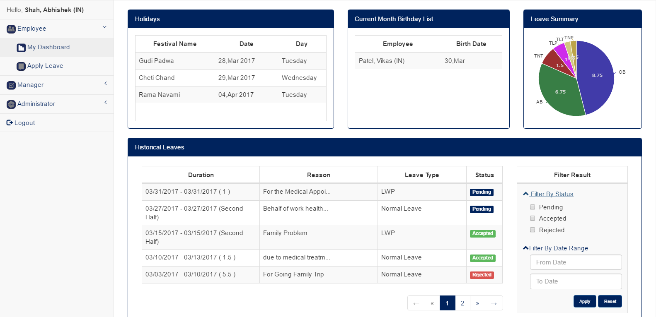
Employee Dashboard Screen

Slide 43
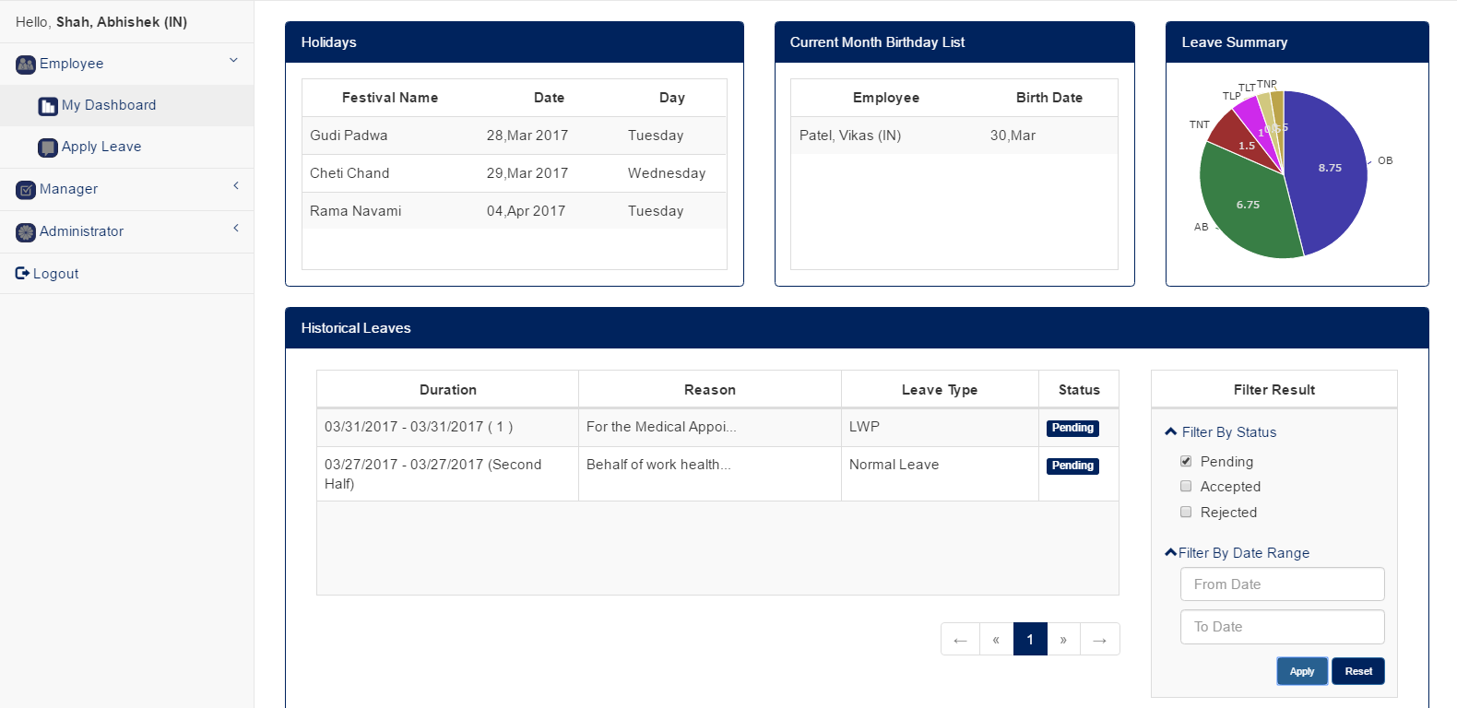
Dashboard With Filtered Leave Record

Slide 44
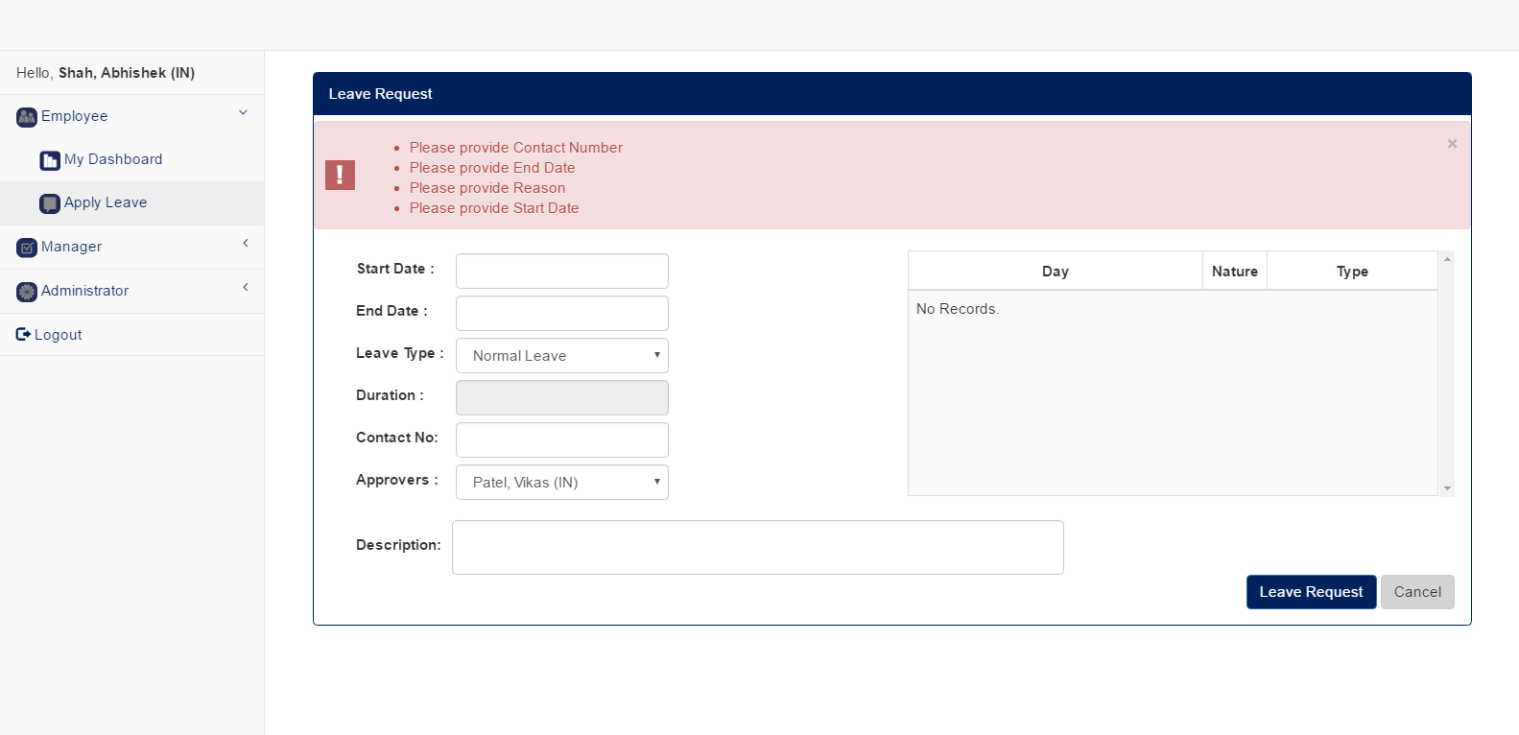
Apply Leave Screen

Slide 45
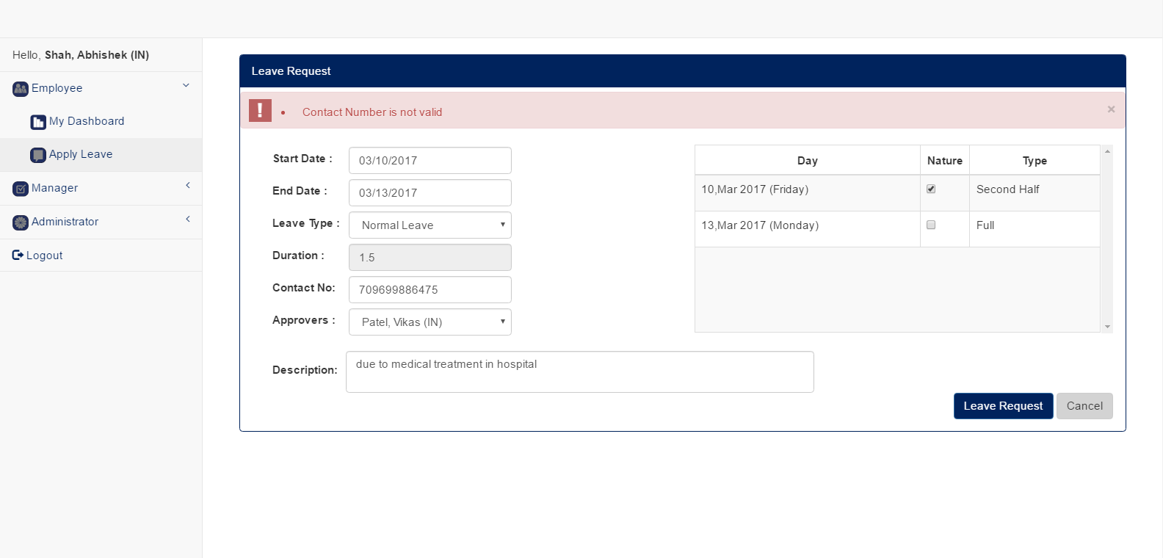
Apply Leave Screen

Slide 46
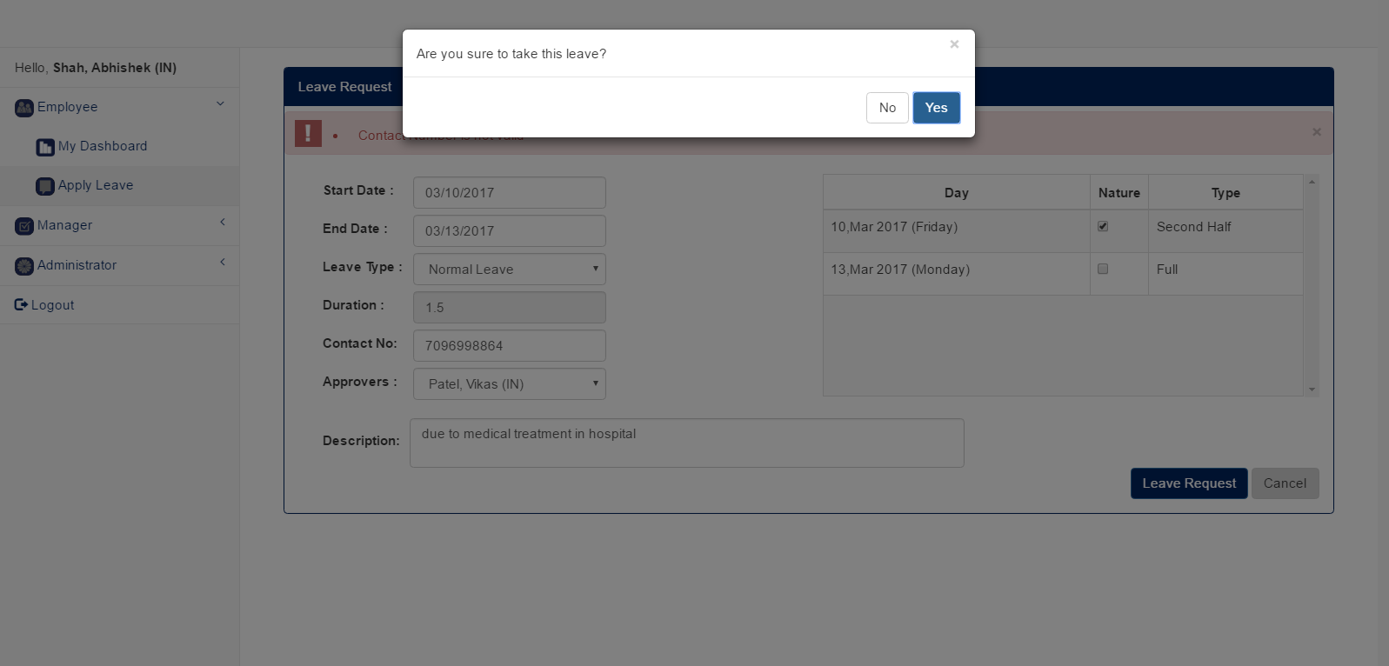
Leave Request Confirmation pop up

Slide 47
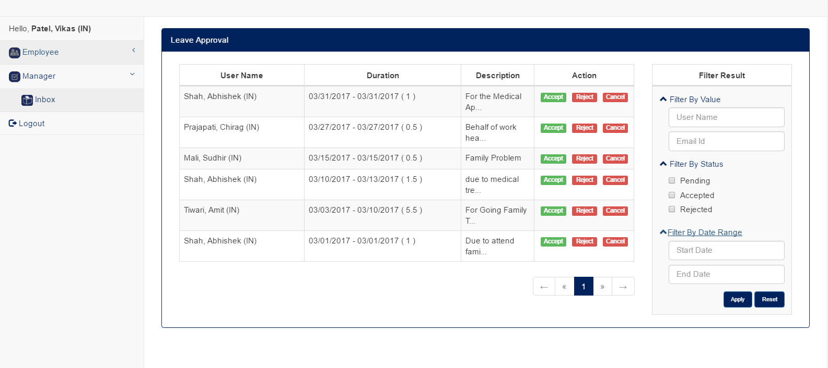
Manager Inbox Screen

Slide 48
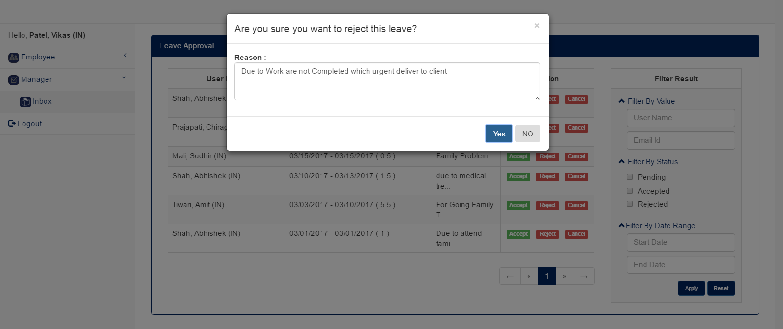
Manager Provide Leave Reject Reason

Slide 49
Generated Reports

Slide 50
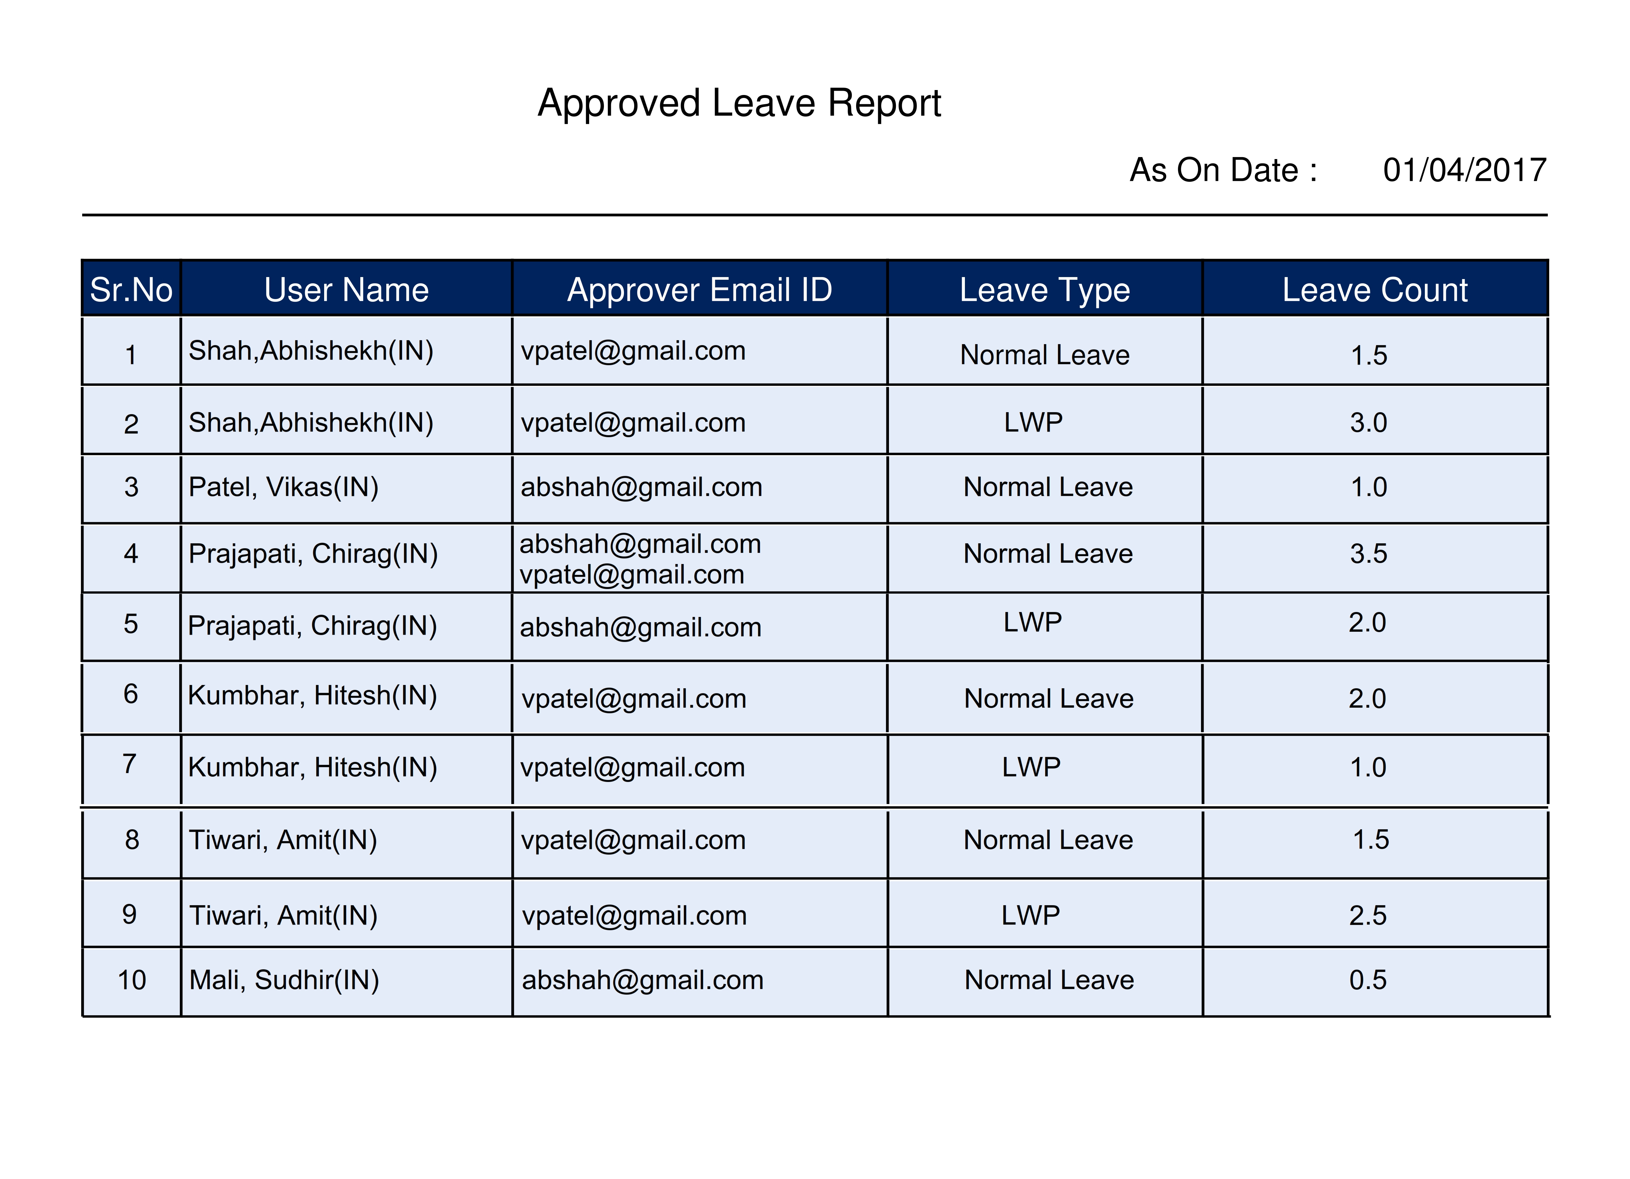
Approved Leave Report

Slide 51
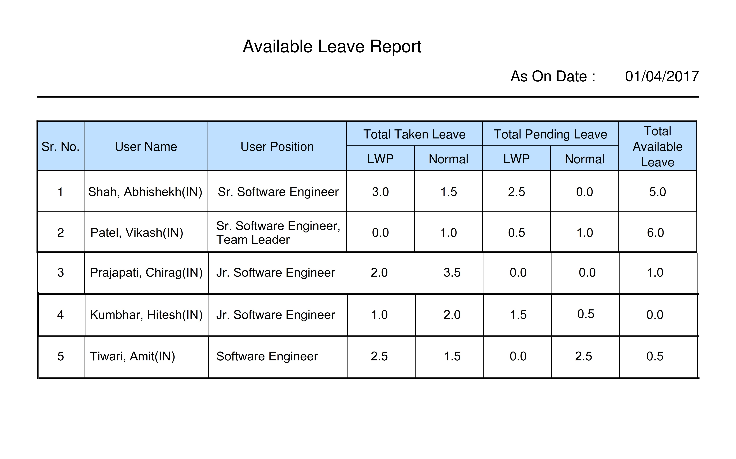
Available Leave Report

Slide 52
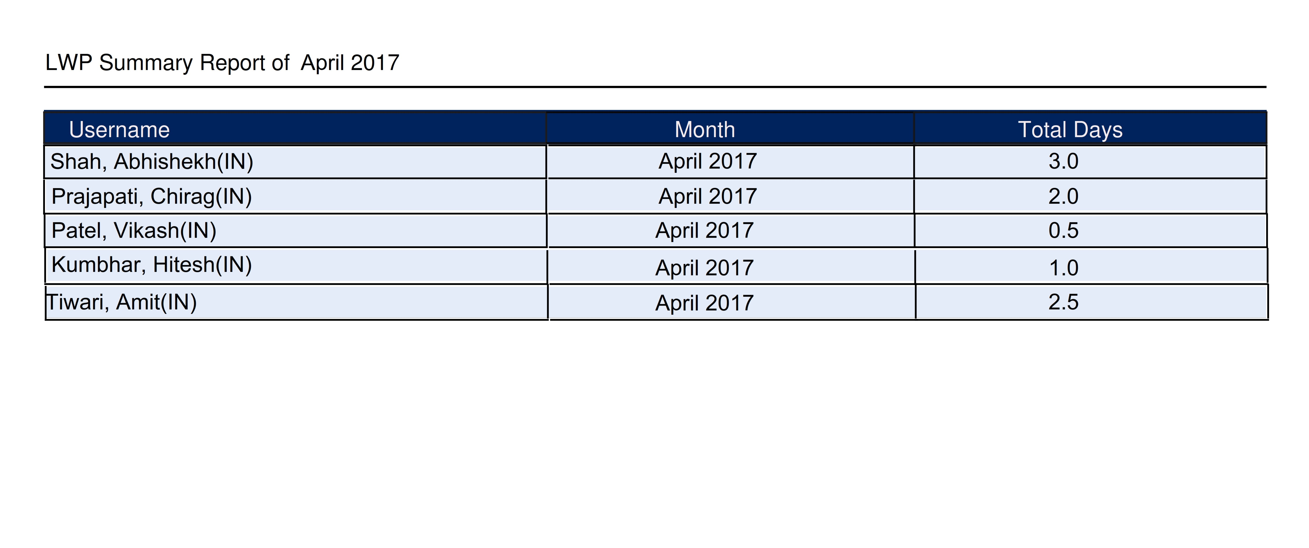
LWP Summary Report

Slide 53
Scope & Limitations
Scope :
This project aimed to developing a web based Leave Management System which fulfilled the requirement of Organization; it is accessed through internet by organization employees, manager and HR person and use as require there is provided different features like email notifications, apply leave request, update leave, cancel leave, leave approval or reject, reports, graphical dashboard which provide leave request history, upcoming user birthday list and holiday list and chart which display leave related information, etc.

Slide 54
Scope & Limitations Cont…
Limitations:
Once leave request approved by the Approval then it would not be able to edit again
Application does not support for multiple time zone. Example, if user has applied the leave from IST time zone that corresponding leave request has representing with wrong date on another time zone.
Application is not accessed out of company place and server.

Slide 55
Future Expansion
Approval or Admin can see individual users detail and full history from joining date to upward.
Improve the application which could be flexible for different time zone.
Integrate the System with access card machine to track working day of employee.

